Slide 1

PowerShell & PowerBi Reducing DBAs Context Switching
Rob Sewell
@sqldbawithbeard
http://sqldbawithAbeard.com
#psconfasia

Slide 2
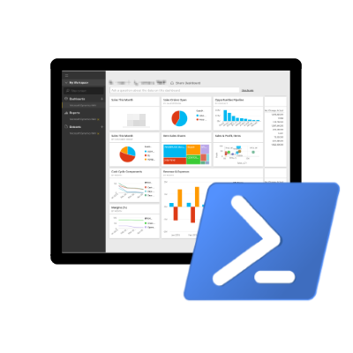
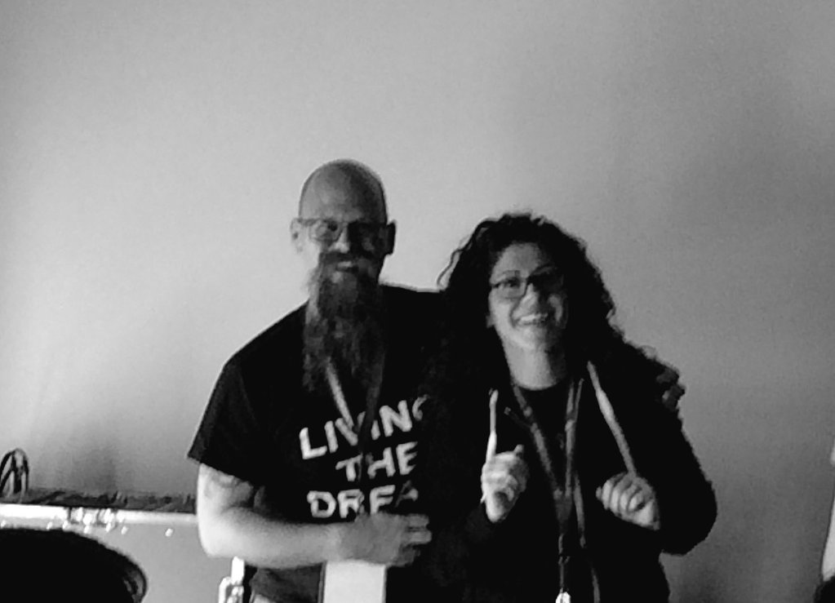
Speaker Questionnaire
Name : Rob
Occupation : DBA, Automator, Do-er
Interests : PowerShell, Automation And SQL (PaaS geddit?)
Website : sqldbawithAbeard.com
Twitter : @sqldbawithbeard
Interesting Fact : Has a Beard. (Still) Plays Cricket
Speaker : SQL Saturdays, SQL Relay, PowerShell Conference EU
Community : SQL South West , SQL Saturday Exeter , PowerShell Virtual Chapter, Organiser for PowerShell Conference EU 2017, Officer, Lead for dbareports, contributor to dbatools
https://dbareports.io
@psdbareports

Slide 3


What Problem are we Solving?
Rob Sewell @sqldbawithbeard

Slide 4
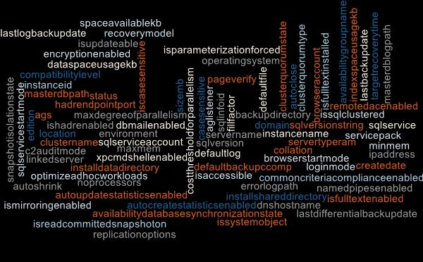
Questions
Managers
PMs
Developers
Compliance
Auditors
DBAs
Change Managers
How Many?
Where Are?
What Is?
Which?
When?
Rob Sewell @sqldbawithbeard
Notes:
Compliance want to know how many Server 2003 or SQL 2005 or XPCMDShellEnabled
Project Managers and the project team want to know which servers and databases for their systems, how big, what settings etc
Systems Team, Change Managers want to know which servers and which clients are in which Data Centre for maintenance work (UPS replacement for example)

Slide 5

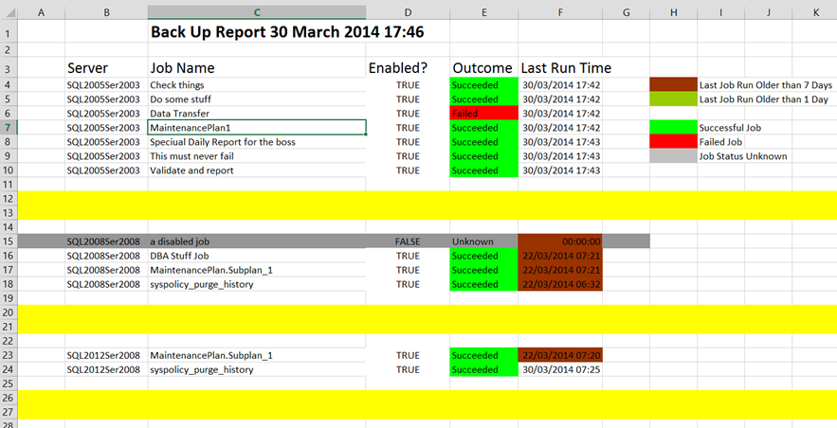
Replace The Old Ways
Rob Sewell @sqldbawithbeard
Notes:
It’s time to move on from the Old Ways of doing things.
I loved my Excel sheet with RAG for every agent job generated every day but in this modern world do we need to be emailing or saving files on shares to get our information

Slide 6
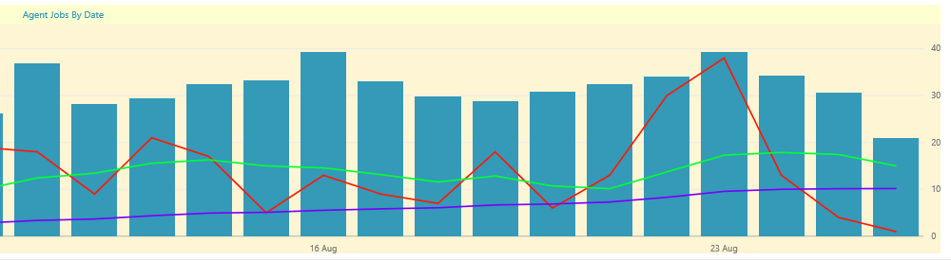
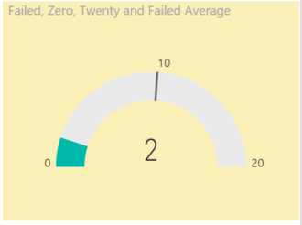
Instant Views For The DBA Team
Rob Sewell @sqldbawithbeard
Notes:
We – The DBA Team want good visualisations of exactly the information that we want to see including averages to see our improvement.
Here we see a rolling 30 day average for failed jobs (Blue) Rolling 7 day average (green) Failed Jobs (Red) and a gauge showing the failed jobs today against the average
But also we can show the number of SQL 2000 instances going down or other goals or objectives that we have a team have been set

Slide 7

Help Yourself
Rob Sewell @sqldbawithbeard
Notes:
Self-Service – Enable the Requestors to get what they want when they want
Reduce the load on the DBA Team

Slide 8



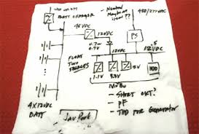

REQUIREMENTS
SOLUTION
Local Knowledge
Rob Sewell @sqldbawithbeard
Notes:
What do we need to build our solution to this problem?
Powershell – to gather our information
SQL Server – to store the information and ensure that it is kept available and backed up (and in control of the DBA Team
Power Bi – to create the reports and view/share them
Local Knowledge – Whether you keep your instances in a CMS or in a text file or on the back of a napkin you will need to know where they are

Slide 9
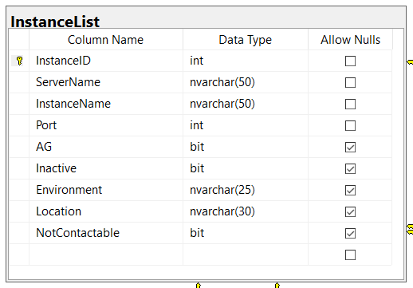

The Manual Part
This used to be a bit of a pain to set up. And then we wrote
And now all it is this
PS Git:\dbareports> Install-DbaReports -SqlServer DBASQLServer
PS Git:\dbareports> Add-DbrServerToInventory -SqlInstance 'ROB-SURFACEBOOK' -Port 1433
-Environment Prod -Location Singapore
Notes:
Enter this information into this table
Ensure Policies, Procedures and Processes include this step for new instances and also that the Inactive flag is set when instances are removed

Slide 10
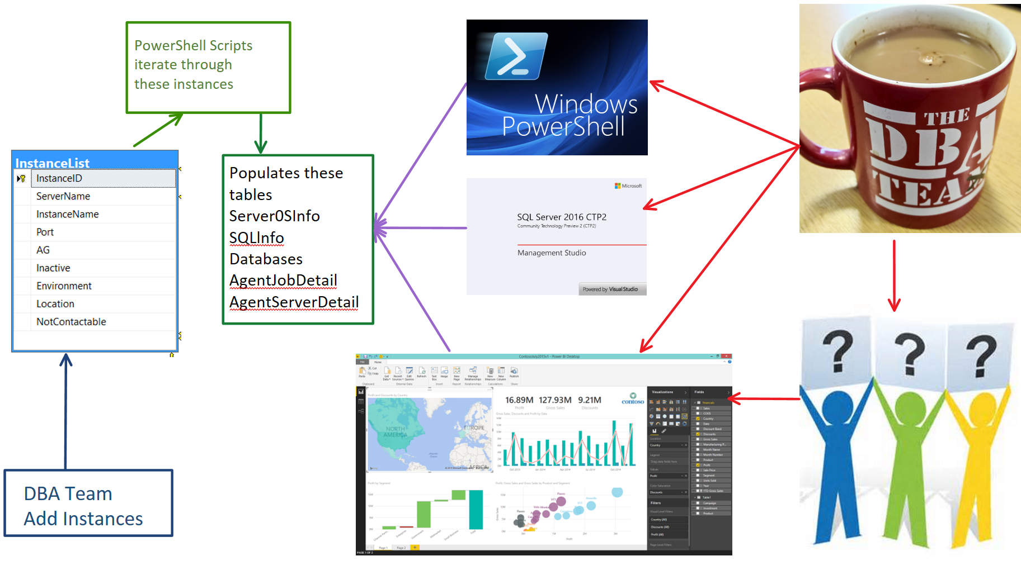
Notes:
DBA – Fills in instances
Agent Jobs run every night to gather the information regularly (Agent Job Databases, every night, Server, SQL every week
Now the DBA Team can use powershell to gather information – My Find-Database function queries this (and we use Excel too so the information is available locally in the case of disaster)
The DBA Team can use TSQL too. The information is pretty up to date and we have the date checked column to see when last checked
They can then answer questions quicker (No need to connect to a server)
They can quickly identify instances which need action (Policies not set (Max mem, Min mem Adhoc workload enabled etc)) and target them with powershell
BUT – Now we can let them ask their own questions ☺ and have access to the data they require when ever they want.

Slide 11

MUST BE TIME
FOR A DEMO

Slide 12
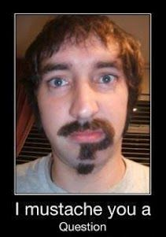
Questions?

